Slide 1
Design and Analysis of Algorithms
National University of Computer and Emerging Sciences, Islamabad

Slide 2
Sorting algorithms
Selection and bubble sort have quadratic best/average/worst-case performance
Insertion sort has quadratic average-case and worst-case performance
The faster comparison based algorithm ?
O(nlogn)
Mergesort and Quicksort

Slide 3
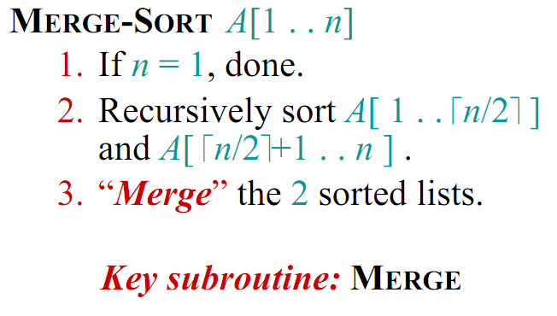
Merge Sort (Divide and Conquer)

Slide 4
Example
Partition into lists of size n/2
[10, 4, 6, 3, 8, 2, 5, 7]
[10, 4, 6, 3]
[8, 2, 5, 7]
[10, 4]
[6, 3]
[8, 2]
[5, 7]
[4] [10]
[3][6]
[2][8]
[5][7]

Slide 5
Example Cont’d
Merge
[2, 3, 4, 5, 6, 7, 8, 10 ]
[3, 4, 6, 10]
[2, 5, 7, 8]
[4, 10]
[3, 6]
[2, 8]
[5, 7]
[4] [10]
[3][6]
[2][8]
[5][7]

Slide 6
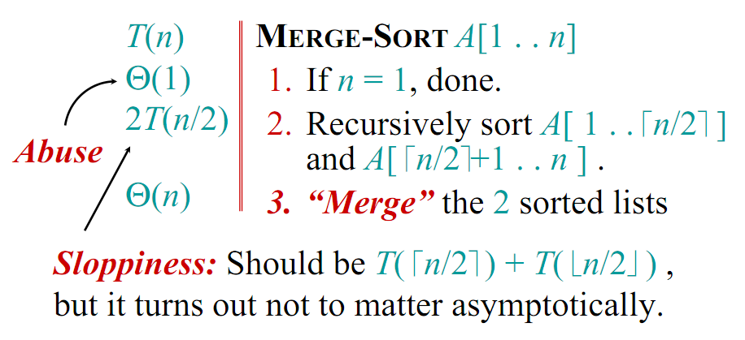
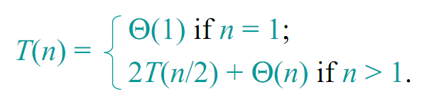
Analysis of Merge Sort

Slide 7
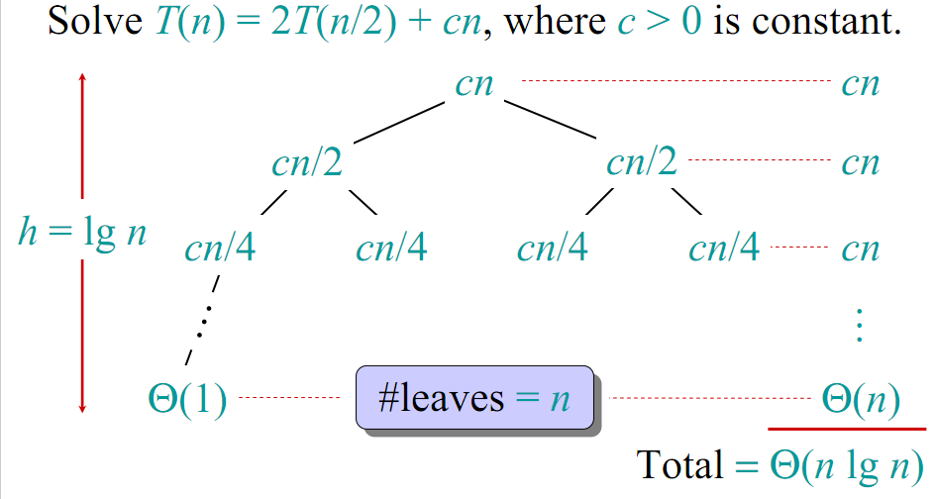
Visual Representation of the Recurrence for Merge Sort

Slide 8
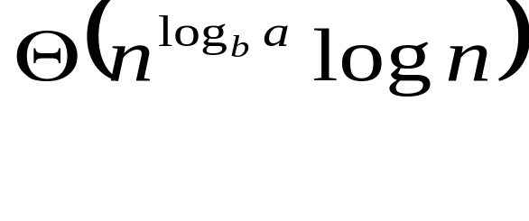
Time Complexity (Using Master Theorem)
Recurrence Relation
T(n)=2T(n/2) + n
Using Master Theorem applying case 2:
So time complexity is Θ(nlogn)

Slide 9
Θ(nlgn) grows more slowly than Θ(n²)
Therefore, merge sort asymptotically beats insertion sort in the worst case.
In practice, merge sort beats insertion sort for n >=3

Slide 10
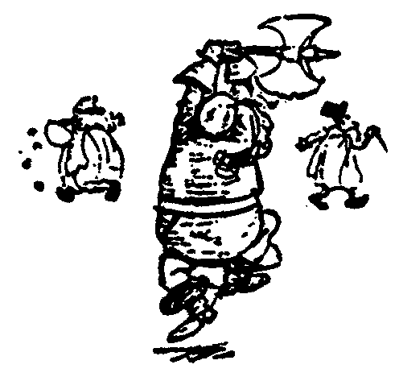
Quick Sort
88
52
14
31
98
25
30
62
23
79
Divide and Conquer

Slide 11
Quick Sort
Partition set into two using
randomly chosen pivot
88
52
14
31
98
25
30
62
23
79
14
88
98
31
30
≤ 52 ≤
62
25
23
79

Slide 12
Quick Sort
14
88
98
31
30
≤ 52 ≤
62
25
23
79
sort the first half.
sort the second half.
14,23,25,30,31
62,79,98,88

Slide 13
Quick Sort
14,23,25,30,31
52
62,79,88,98
Glue pieces together.
14,23,25,30,31,52,62,79,88,98

Slide 14
Quicksort
Quicksort pros [advantage]:
  Sorts in place
  Sorts O(n lg n) in the average case
  Very efficient in practice , it’s quick
Quicksort cons [disadvantage]:
  Sorts O(n²) in the worst case
  And the worst case doesn’t happen often … sorted

Slide 15
Quicksort
Another divide-and-conquer algorithm:
Divide: A[p…r] is partitioned (rearranged) into two nonempty subarrays A[p…q-1] and A[q+1…r] s.t. each element of A[p…q-1] is less than or equal to each element of A[q+1…r]. Index q is computed here, called pivot.
Conquer: two subarrays are sorted by recursive calls to quicksort.
Combine: unlike merge sort, no work needed since the subarrays are sorted in place already.

Slide 16
Quicksort
The basic algorithm to sort an array A consists of the following four easy steps:
  If the number of elements in A is 0 or 1, then return
  Pick any element v in A. This is called the pivot
  Partition A-{v} (the remaining elements in A) into two disjoint groups:
    A₁ = {x ∈ A-{v} | x ≤ v}, and
    A₂ = {x ∈ A-{v} | x ≥ v}
  return
    { quicksort(A₁) followed by v followed by quicksort(A₂)}

Slide 17
Quicksort
Small instance has n ≤ 1
  Every small instance is a sorted instance
To sort a large instance:
  select a pivot element from out of the n elements
Partition the n elements into 3 groups left, middle and right
  The middle group contains only the pivot element
  All elements in the left group are ≤ pivot
  All elements in the right group are ≥ pivot
Sort left and right groups recursively
Answer is sorted left group, followed by middle group followed by sorted right group

Slide 18
Quicksort Code
P: first element
r: last element
Quicksort(A, p, r)
{
if (p < r)
{
q = Partition(A, p, r)
Quicksort(A, p , q-1)
Quicksort(A, q+1 , r)
}
}
Initial call is Quicksort(A, 1, n), where n in the length of A

Slide 19
Partition
Clearly, all the action takes place in the partition() function
  Rearranges the subarray in place
  End result:
    Two subarrays
    All values in first subarray ≤ all values in second
  Returns the index of the “pivot” element separating the two subarrays

Slide 20
Partition Code
Partition(A, p, r)
{
x = A[r] // x is pivot
i = p - 1
for j = p to r – 1
{
do if A[j] <= x
then
{
i = i + 1
exchange A[i] ↔ A[j]
}
}
exchange A[i+1] ↔ A[r]
return i+1
}
partition() runs in O(n) time

Slide 21
Partition Example
A = {2, 8, 7, 1, 3, 5, 6, 4}
i
p j
r
p i
j
r
2 8 7 1 3 5 6 4
2
2 8 7 1 3 5 6 4
p i
j
r
p i
j
r
2
2 8 7 1 3 5 6 4
2
8
7
1
3
5
6
4
p
i
j
r
p
i
j
r
2
2
1
3
5
6
4
2
2
1
1
3
7
8
3
8
7
5
6
4
p
i
j
r
p
i
r
2
1
6
4
2
1
3
3
8
7
5
2
2
1
1
3
4
3
8
7
5
6
p
i
r
2
2
1
1
3
3
4
7
5
6
8

Slide 22
Partition Example Explanation
Red shaded elements are in the first partition with values ≤ x (pivot)
Gray shaded elements are in the second partition with values ≥ x (pivot)
The unshaded elements have no yet been put in one of the first two partitions
The final white element is the pivot

Slide 23
Choice Of Pivot
Three ways to choose the pivot:
Pivot is rightmost element in list that is to be sorted
  When sorting A[6:20], use A[20] as the pivot
  Textbook implementation does this
Randomly select one of the elements to be sorted as the pivot
  When sorting A[6:20], generate a random number r in the range [6, 20]
  Use A[r] as the pivot

Slide 24
Choice Of Pivot
Median-of-Three rule - from the leftmost, middle, and rightmost elements of the list to be sorted, select the one with median key as the pivot
  When sorting A[6:20], examine A[6], A[13] ((6+20)/2), and A[20]
  Select the element with median (i.e., middle) key
  If A[6].key = 30, A[13].key = 2, and A[20].key = 10, A[20] becomes the pivot
  If A[6].key = 3, A[13].key = 2, and A[20].key = 10, A[6] becomes the pivot

Slide 25
Worst Case Partitioning
The running time of quicksort depends on whether the partitioning is balanced or not.
Θ(n) time to partition an array of n elements
Let T(n) be the time needed to sort n elements
T(0) = T(1) = c, where c is a constant
When n > 1,
  T(n) = T(|left|) + T(|right|) + Θ(n)
T(n) is maximum (worst-case) when either |left| = 0 or |right| = 0 following each partitioning

Slide 26
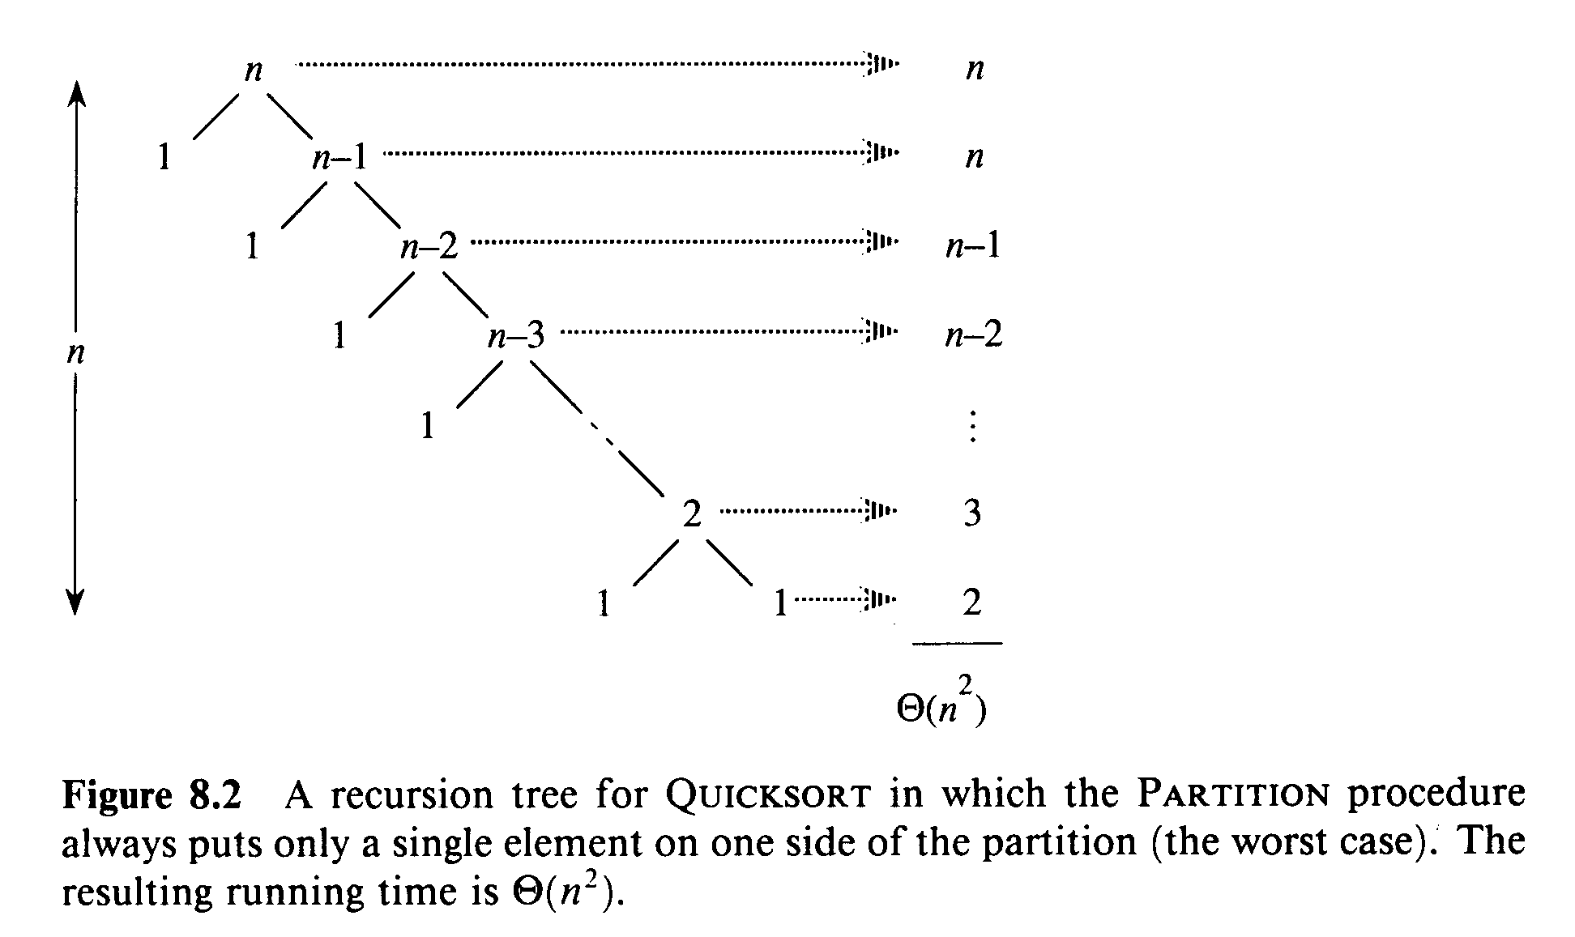
Worst Case Partitioning

Slide 27
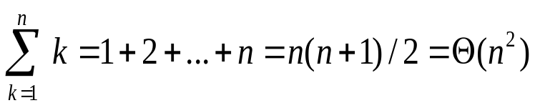
Worst Case Partitioning
Worst-Case Performance (unbalanced):
  T(n) = T(0) + T(n-1) + Θ(n)
    partitioning takes Θ(n)
  = Θ(n²)
This occurs when
  the input is completely sorted
or when
  the pivot is always the smallest (largest) element

Slide 28
Best Case Partition
When the partitioning procedure produces two regions of size n/2, we get the a balanced partition with best case performance:
  T(n) = 2T(n/2) + Θ(n) = Θ(n lg n)
Average complexity is also Θ(n lg n)

Slide 29
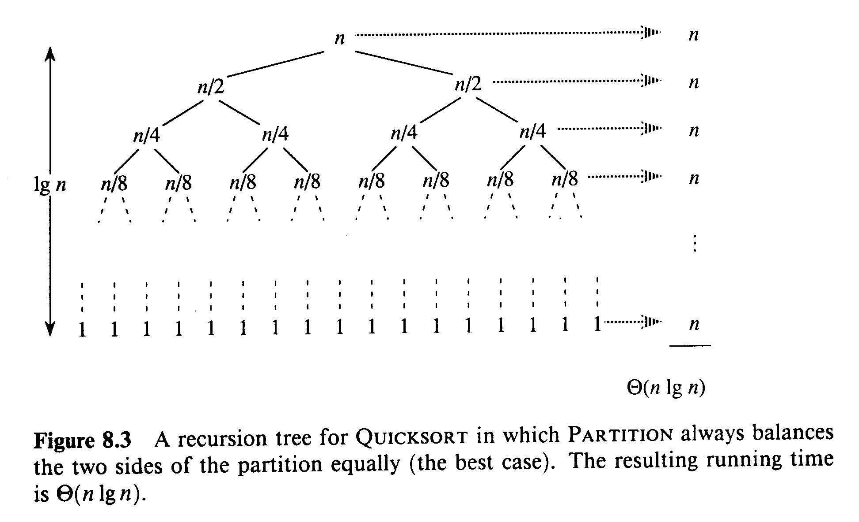
Best Case Partitioning

Slide 30
Average Case
Assuming random input, average-case running time is much closer to Θ(n lg n) than Θ(n²)
First, a more intuitive explanation/example:
  Suppose that partition() always produces a 9-to-1 proportional split. This looks quite unbalanced!
  The recurrence is thus:
  T(n) = T(9n/10) + T(n/10) + Θ(n) = Θ(n lg n)?
  [Using recursion tree method to solve]

Slide 31
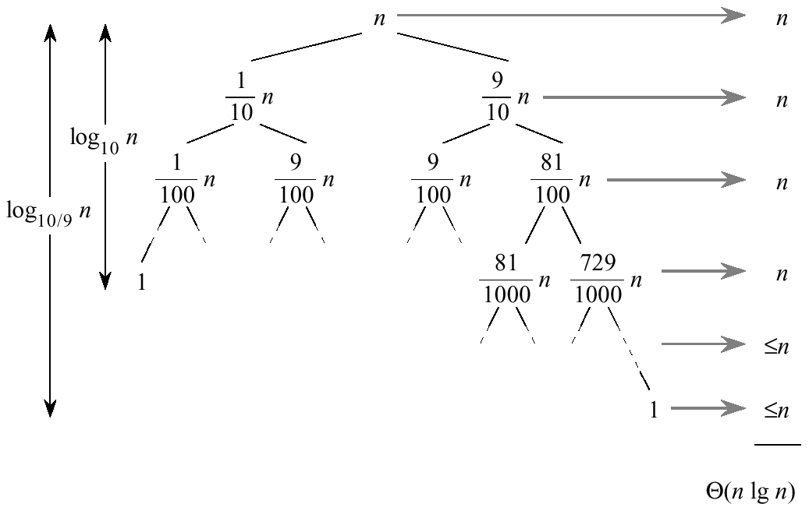
Average Case

Slide 32
Average Case
Every level of the tree has cost cn, until a boundary condition is reached at depth log₁₀ n = Θ( lgn), and then the levels have cost at most cn.
The recursion terminates at depth log_{10/9} n= Θ(lg n).
The total average cost of quicksort is therefore Θ(n lg n).

Slide 33
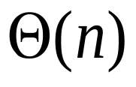
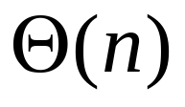

Average Case
What happens if we bad-split root node, then good-split the resulting size (n-1) node?
  We end up with three subarrays, size
    0, ((n-1)/2)-1, (n-1)/2
  Combined cost of splits = Θ(n) + Θ(n-1) = Θ(n)
n
n
0
n-1
((n-1)/2)-1
(n-1)/2
(n-1)/2
(n-1)/2

Slide 34
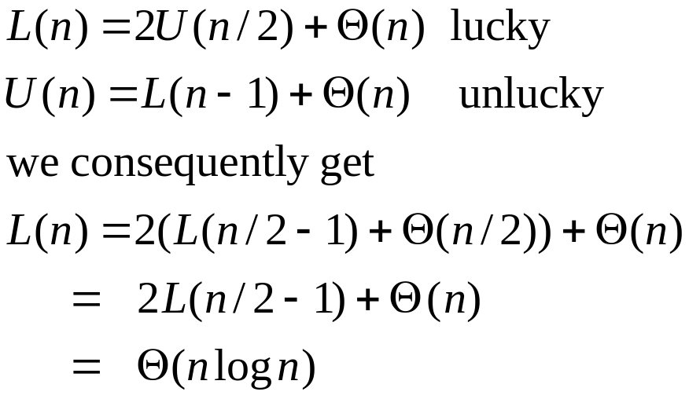
Intuition for the Average Case
Suppose, we alternate lucky and unlucky cases to get an average behavior
The combination of good and bad splits would result in
T(n) = O (n lg n), but with slightly larger constant hidden by the O-notation.
Notes:
larger constant in the O notation

Slide 35
Randomized Quicksort
An algorithm is randomized if its behavior is determined not only by the input but also by values produced by a random-number generator.
Exchange A[r] with an element chosen at random from A[p…r] in Partition.
This ensures that the pivot element is equally likely to be any of input elements.
We can sometimes add randomization to an algorithm in order to obtain good average-case performance over all inputs.

Slide 36
Randomized Quicksort
Randomized-Partition(A, p, r)
1. i ← Random(p, r)
2. exchange A[r] ↔ A[i]
3. return Partition(A, p, r)
Randomized-Quicksort(A, p, r)
1. if p < r
2. then q ← Randomized-Partition(A, p, r)
3. Randomized-Quicksort(A, p , q-1)
4. Randomized-Quicksort(A, q+1, r)
swap
pivot

Slide 37
Review: Analyzing Quicksort
What will be the worst case for the algorithm?
  Partition is always unbalanced
What will be the best case for the algorithm?
  Partition is balanced

Slide 38
Summary: Quicksort
In worst-case, efficiency is Θ(n²)
  But easy to avoid the worst-case
On average, efficiency is Θ(n lg n)
Better space-complexity than mergesort.
In practice, runs fast and widely used

Slide 39
Linear Time Sorting
Count Sort
Radix Sort
Bucket Sort

Slide 40
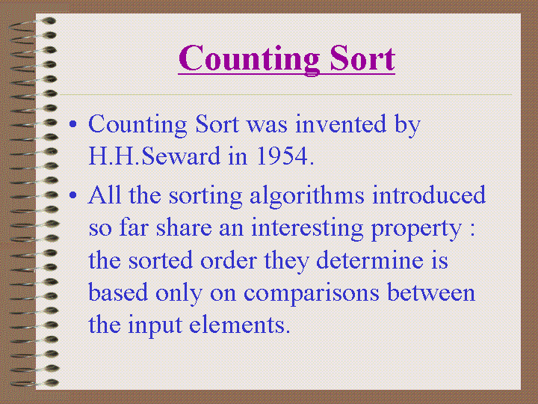

Slide 41
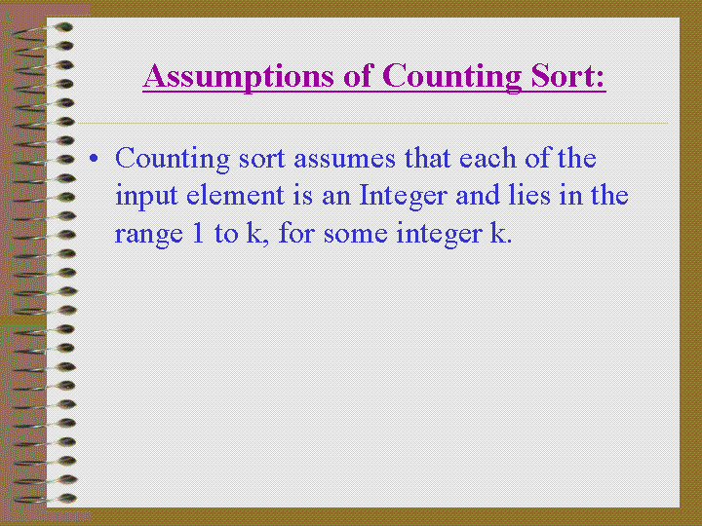
When k = O(n) then the sort runs in O(n) time
Determine how many elements are less than an element x
Then place x directly in its correct position

Slide 42
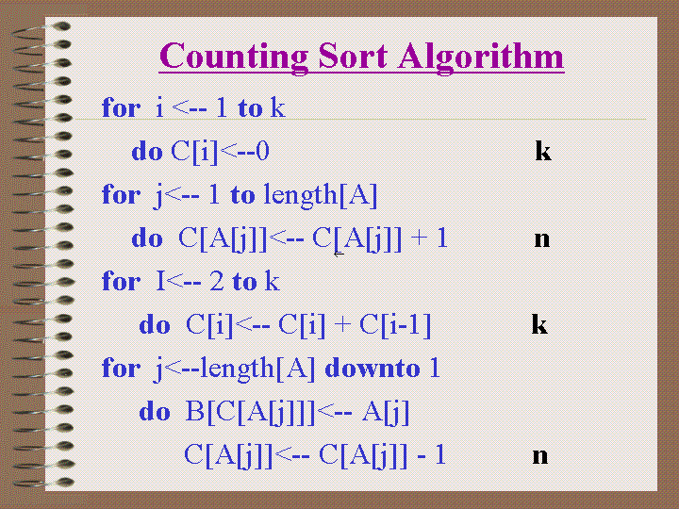

Slide 43
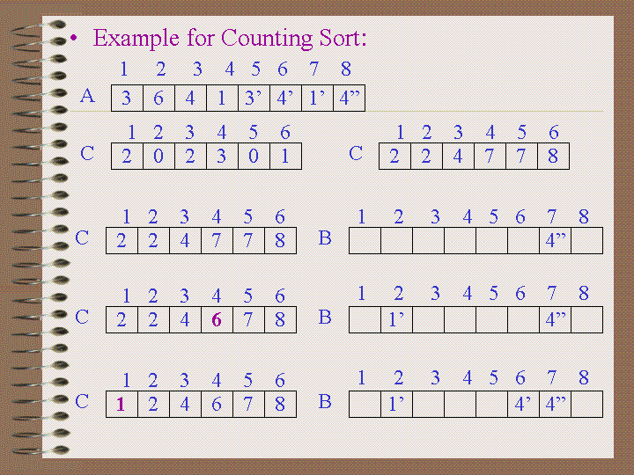

Slide 44
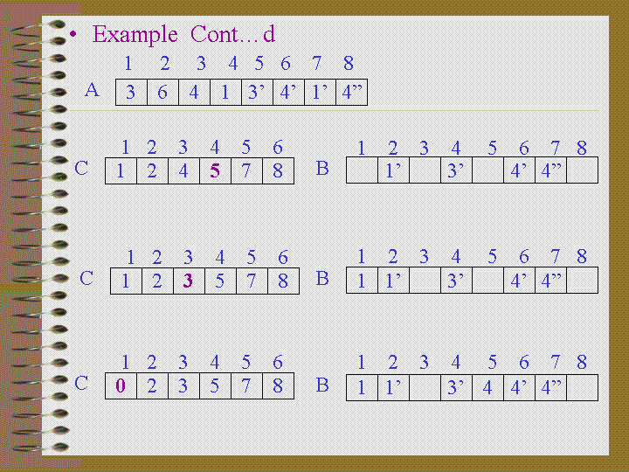

Slide 45
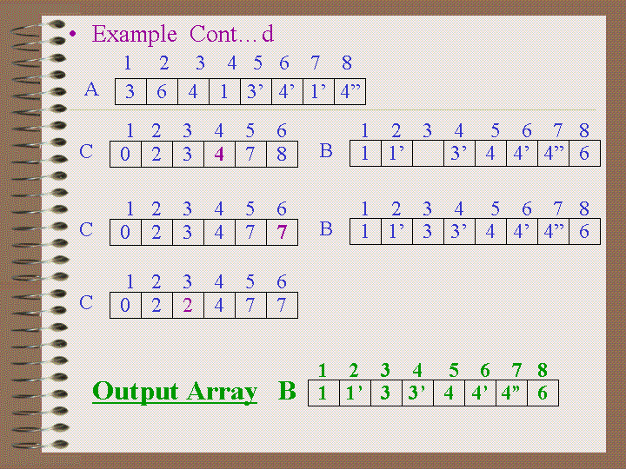

Slide 46
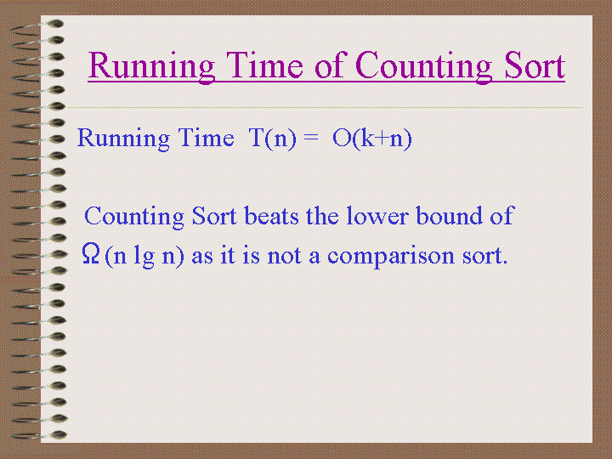

Slide 47
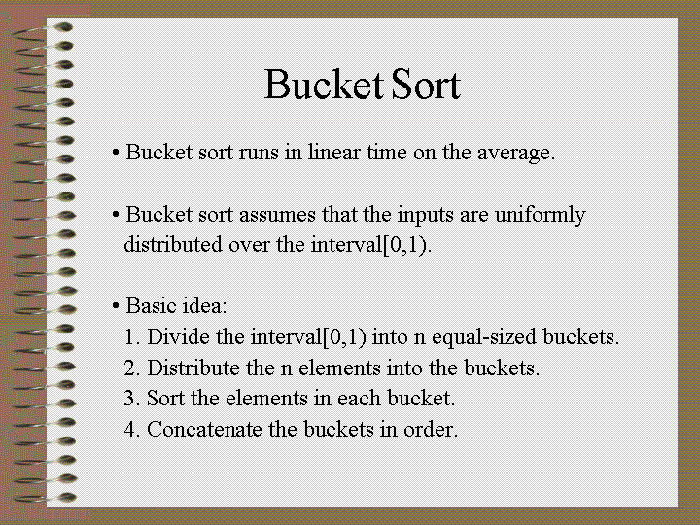

Slide 48
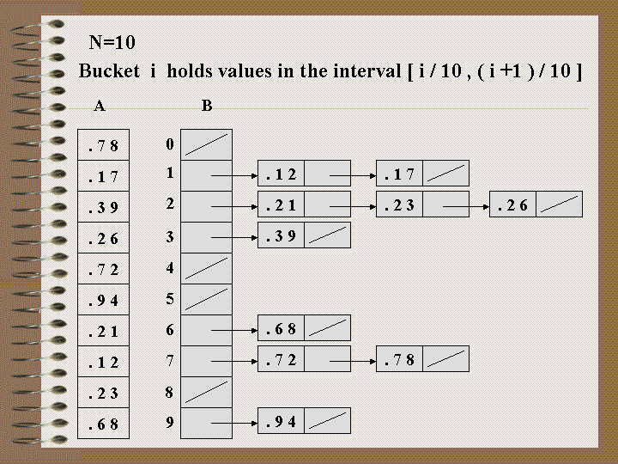

Slide 49
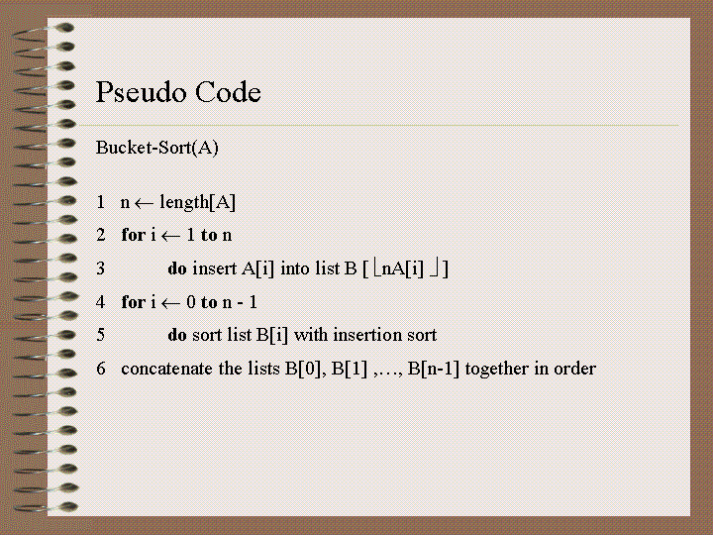

Slide 50
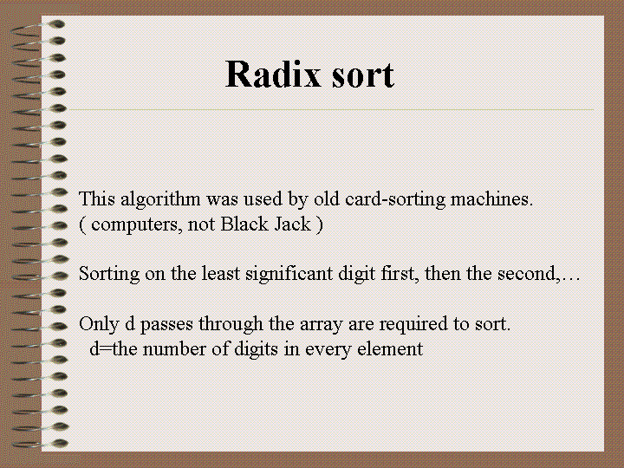

Slide 51
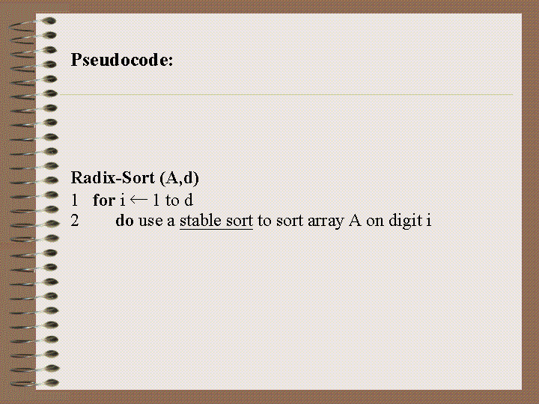

Slide 52
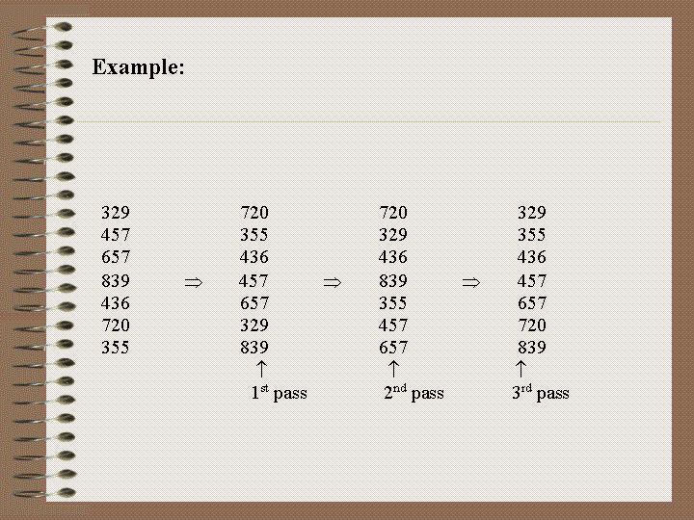

Slide 53
